Slide 1

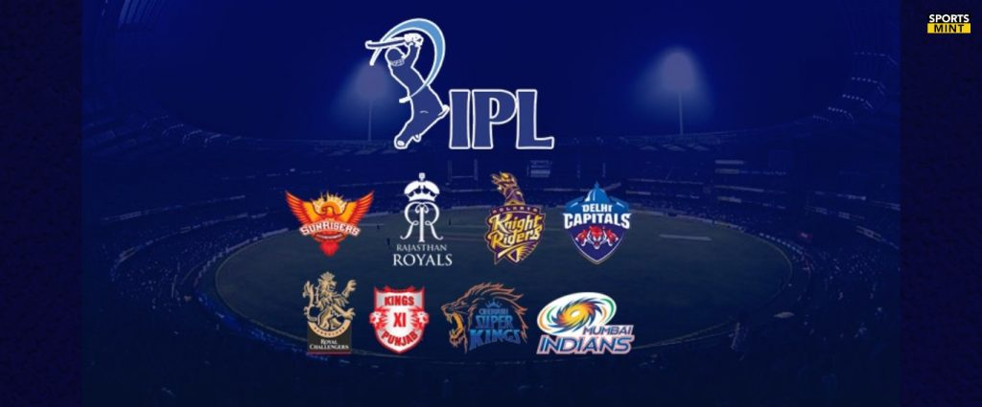
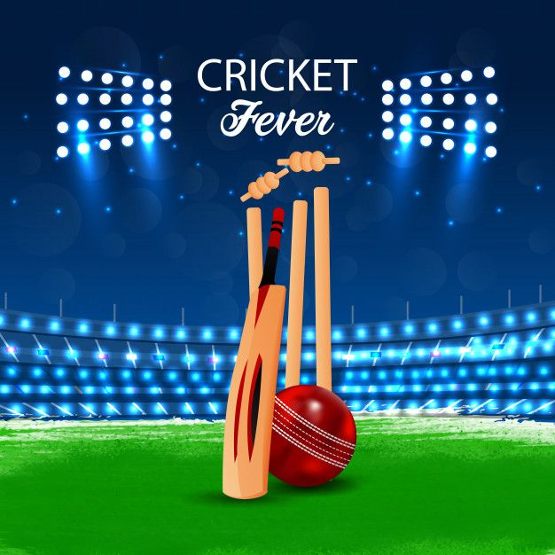
Sports Basics: IPL 2024 Special Edition
Welcome to the IPL 2024 Special Edition of Sports Basics Magazine! Get ready for an in-depth look at the latest trends, insights, and storylines from the world's most exciting T20 cricket league.
BY
V SUSHMA DEVI

Slide 2
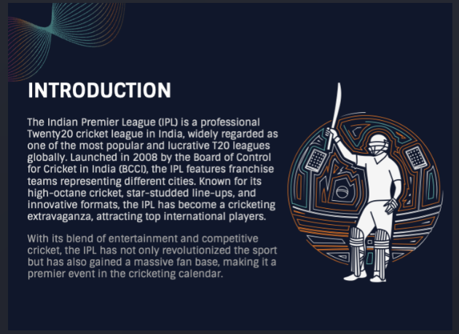

Slide 3
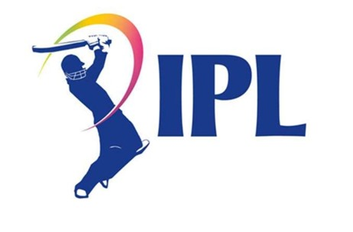
Problem statement
.
"Sports Basics" is a sports blog company that entered space recently.
They wanted to get more traffic to their website by releasing a special edition magazine on IPL 2024.
This magazine aims to provide interesting insights and facts for fans, analysts and teams based on the last 3 years' data.
The chief editor Tony Sharma oversees this publication, and he believes in data analytics.
He reached out to Peter Pandey, a journalist in his team who is a data savvy cricket enthusiast.

Slide 4
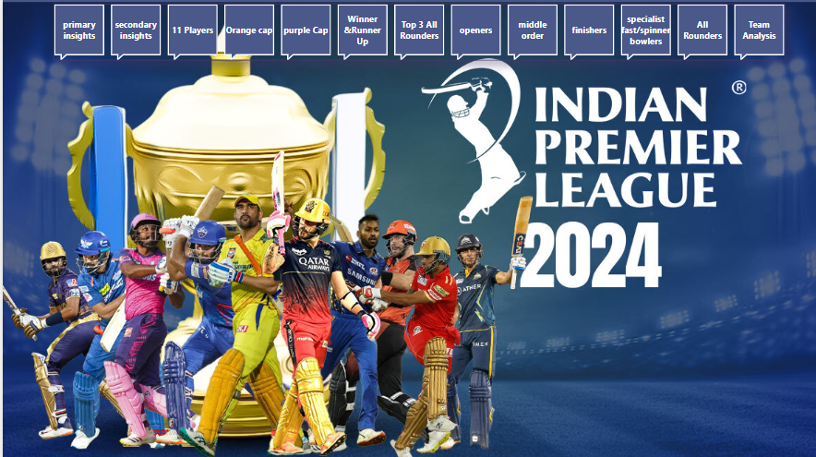
dashboard

Slide 5
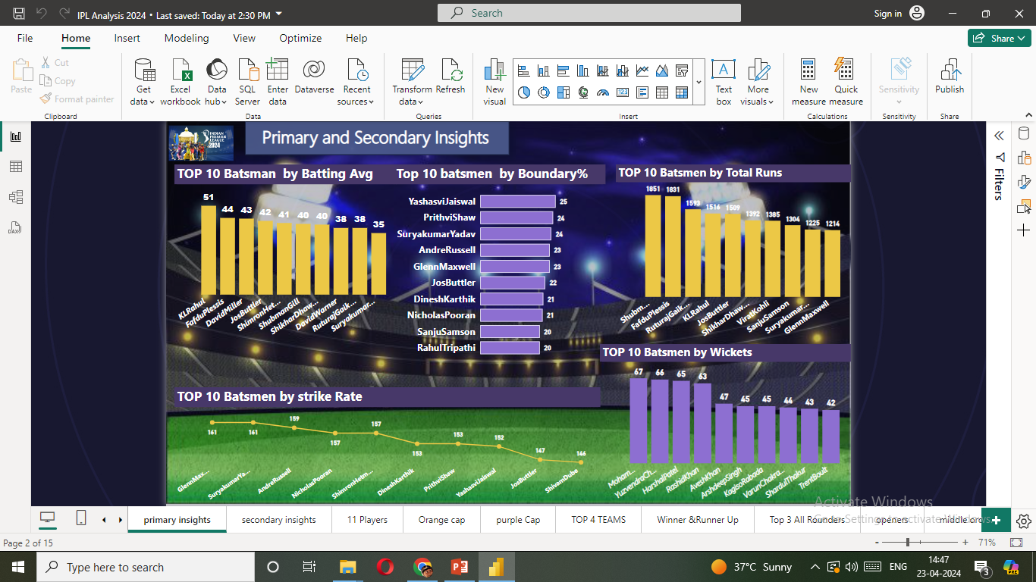

Slide 6
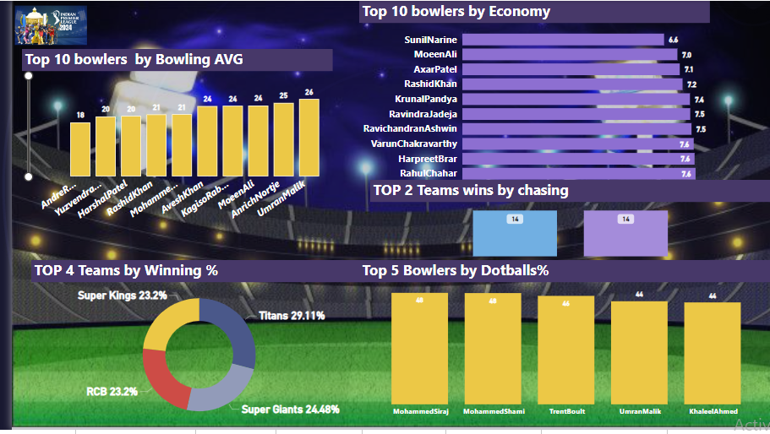

Slide 7
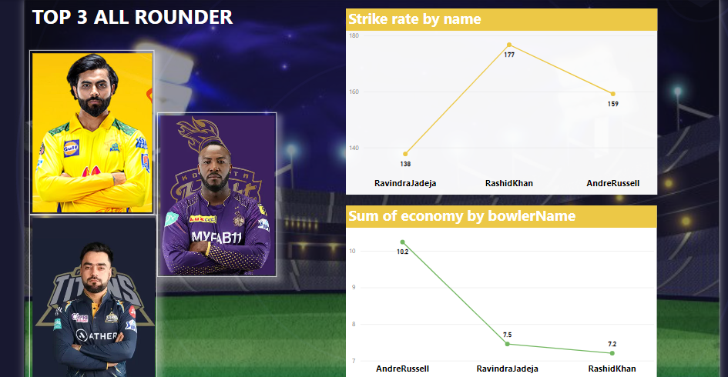

Slide 8
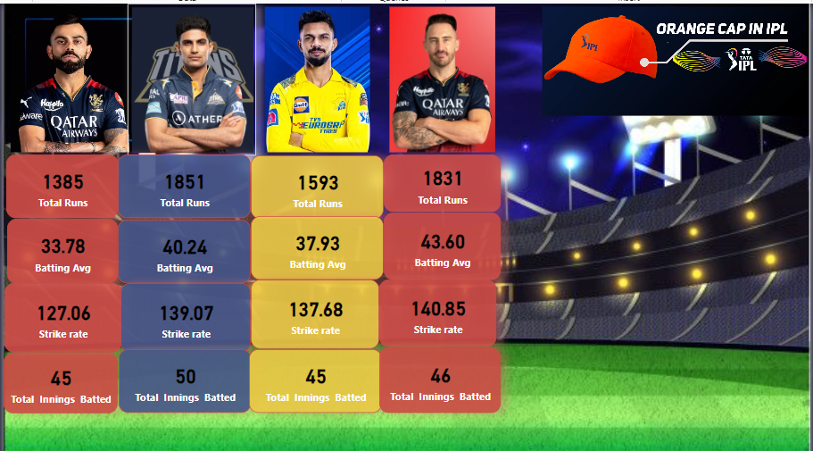
Orange cap holder 2024 prediction

Slide 9
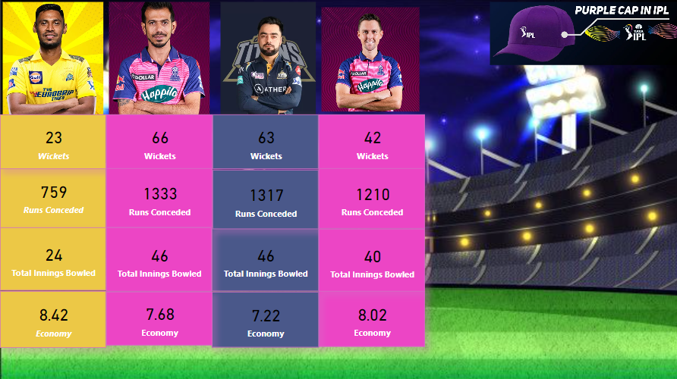
Purple Cap holder 2024 Prediction

Slide 10
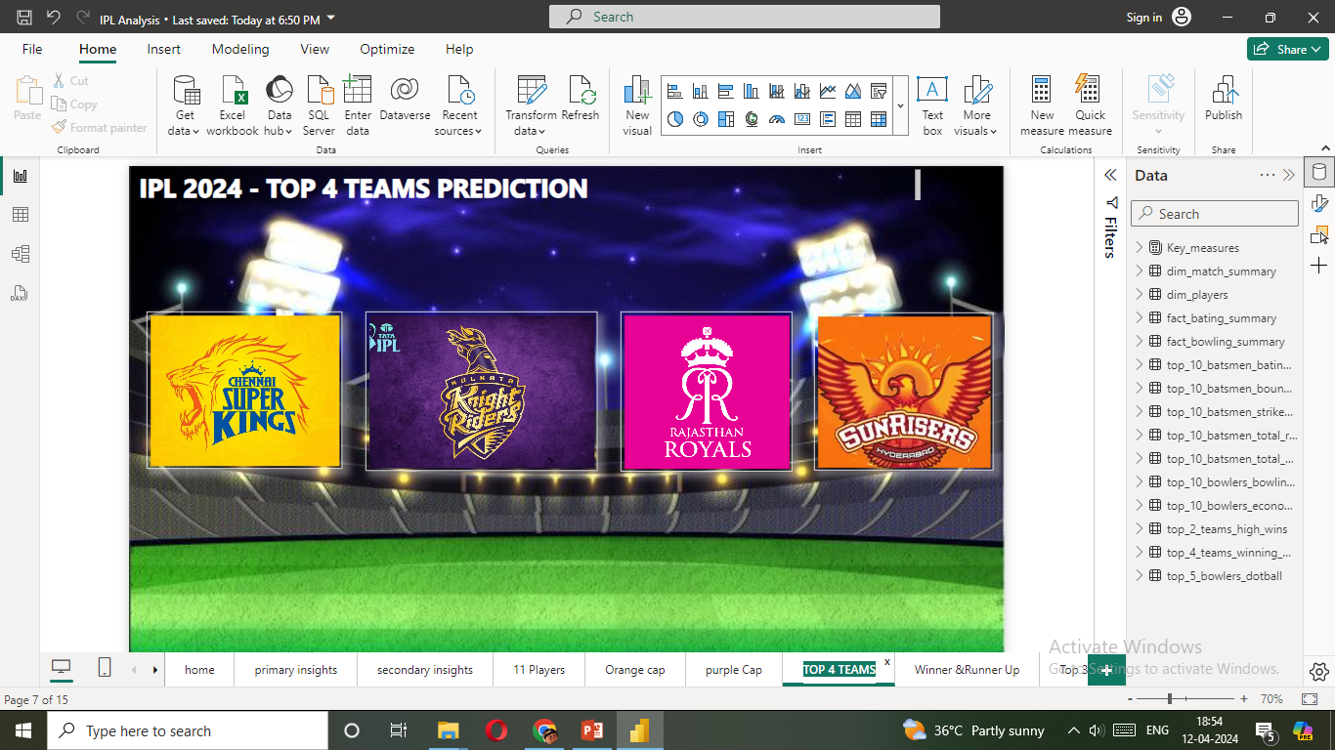
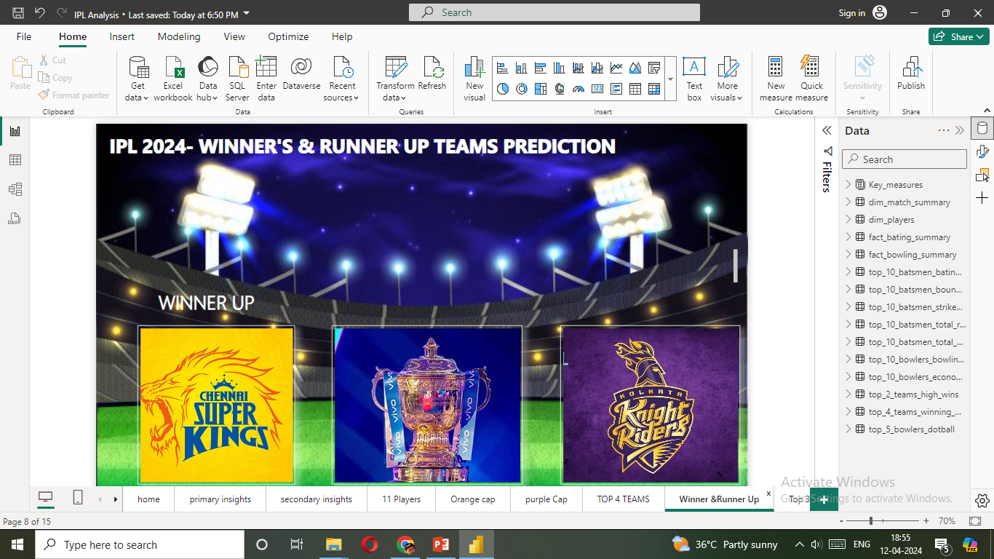

Slide 11
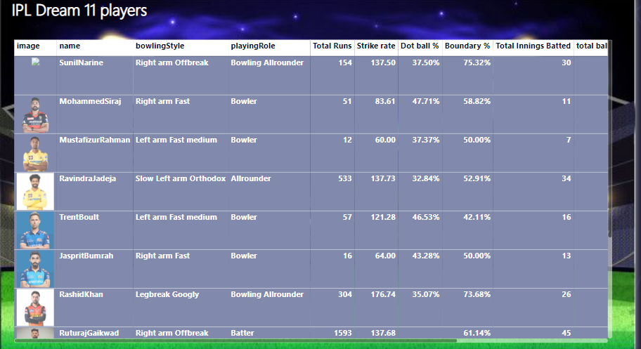

Slide 12
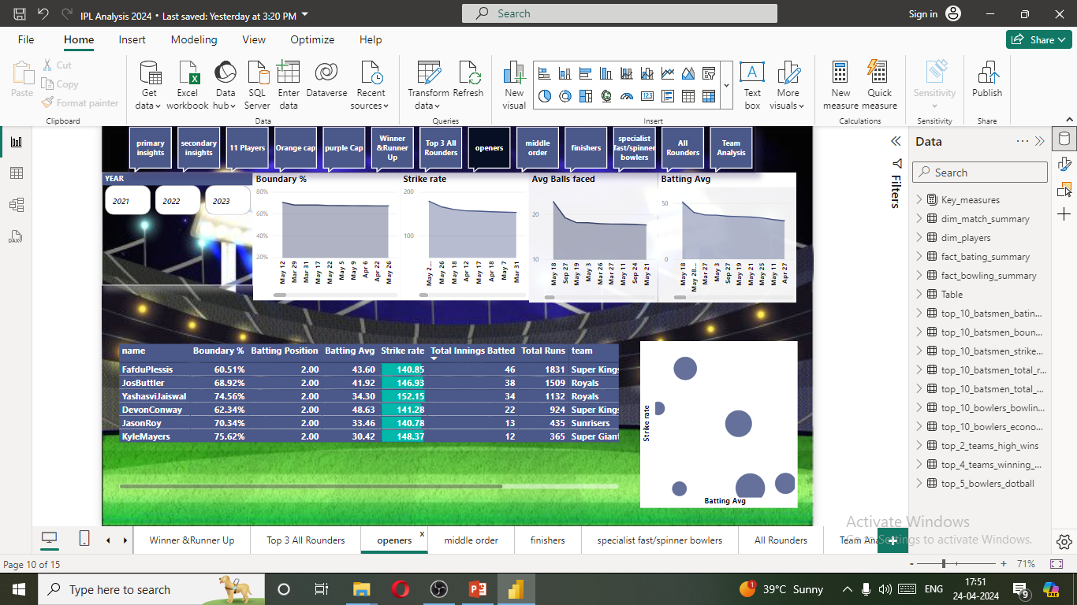
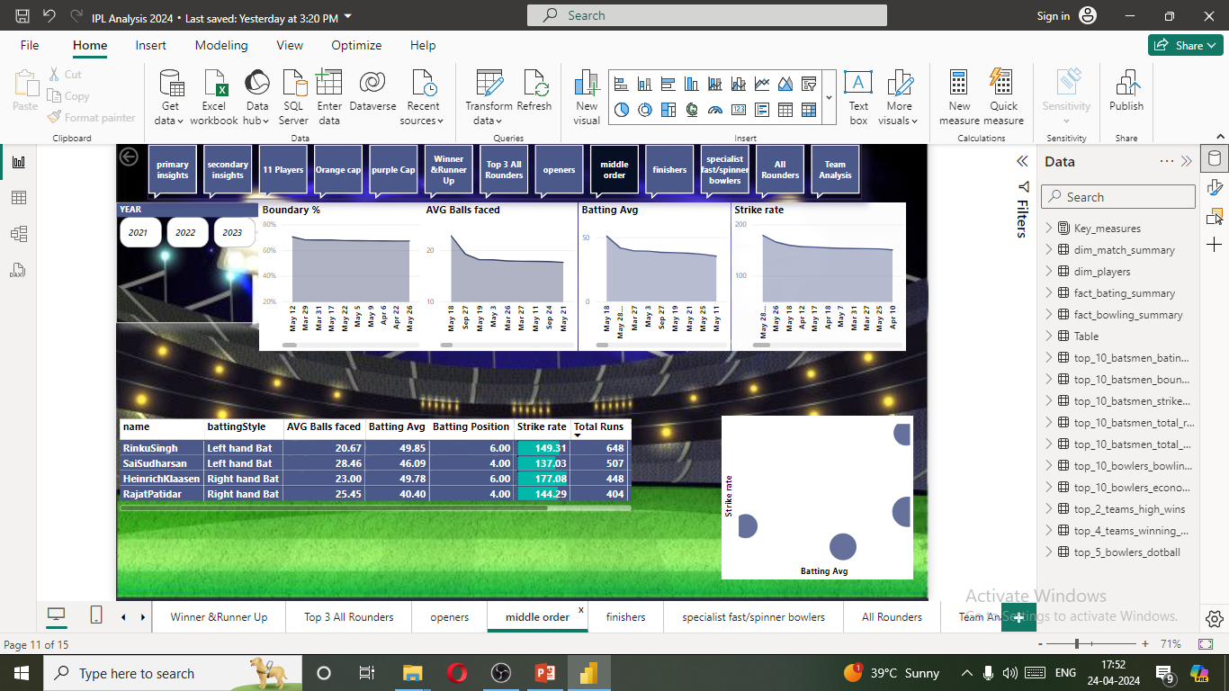
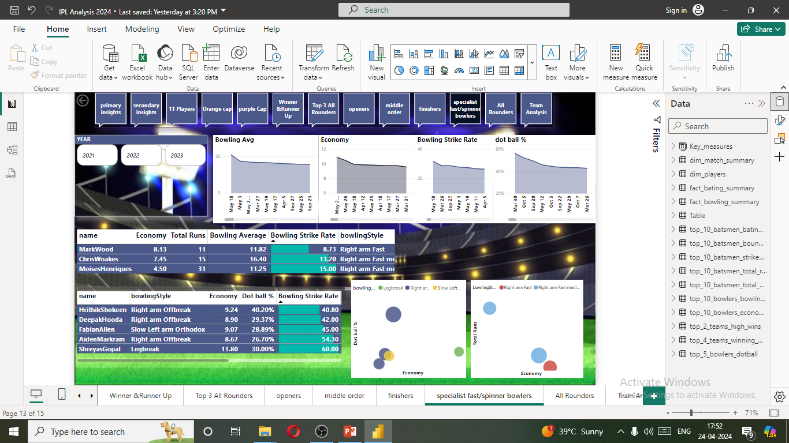
Power Hitters /Opener ‘s batting Analysis
Anchors/Middle order batting Analysis
Fast Bowler’s bowling Analysis
Spinner’s bowling Analysis

Slide 13
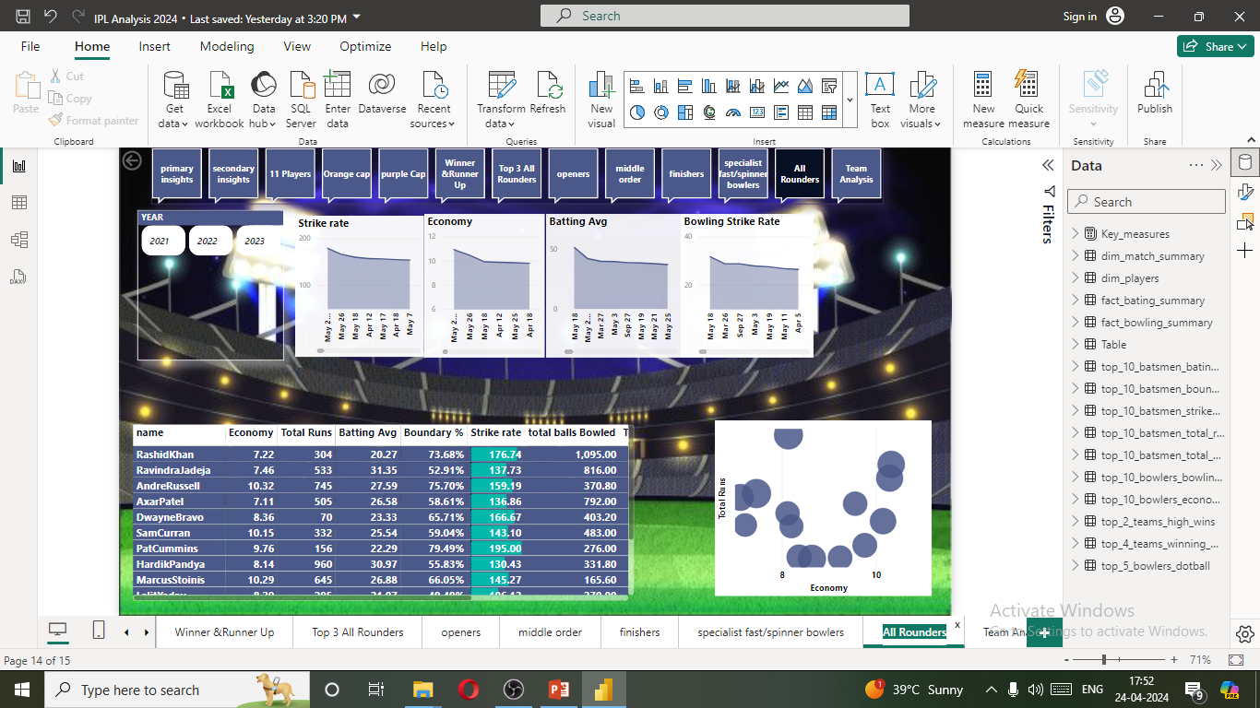
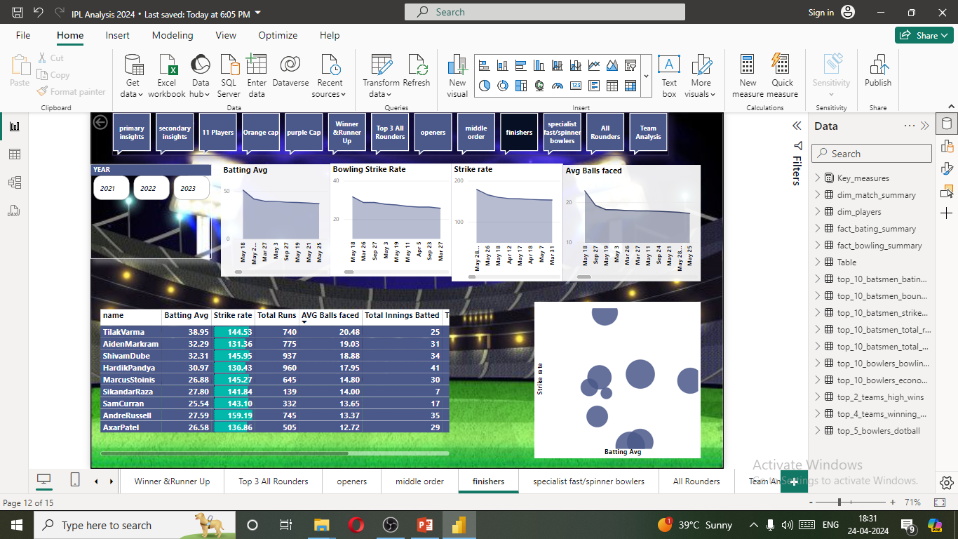
All Rounder’s Analysis
Finisher’s Analysis

Slide 14
Some additional insights for analyzing IPL 2024 cricket:
Match Conditions Analysis: Assess the impact of match conditions such as pitch quality, weather, and stadium dimensions on team strategies and player performance. Certain players may excel in specific conditions, influencing team selection and match outcomes.
2. Team Dynamics and Strategy: Analyze team dynamics, including leadership styles, team cohesion, and strategic approaches. Understanding how teams adapt their tactics during matches and across the tournament can provide valuable insights into their success.
3.Injury and Fitness Analysis: Monitor player fitness levels and injury reports throughout the tournament. Injuries can significantly impact team performance, especially if key players are sidelined or playing through injuries that affect their form.
4. Tactical Analysis : Explore tactical innovations and trends in IPL 2024, such as innovative batting orders, bowling strategies, and fielding placements. Identifying successful tactical approaches can help anticipate future trends and strategies in the game.
5. Youth and Emerging Talent: Keep an eye on young and emerging players who could make a significant impact on the tournament. Tracking their performances and development throughout the IPL can provide valuable insights into future stars of the game.
6.Impact of Rule Changes : Consider the impact of any rule changes implemented for IPL 2024 on team strategies and player performances. Rule modifications, such as power play variations or new fielding restrictions, can influence match dynamics and outcomes.

Slide 15
THANK YOU

